Slide 1
Style Transformation
Course Code : DA526 Instructor : Debanga Raj Neog
Group #22
Vudatha Venkata Narendra
Kaja Gnana Prakash
Karthik Maddala
Tejas Chandra Karreddula
Ashish Kumar Pal

Slide 2

Problem Statement
Imagine that you can create a true artwork by yourself, turning your own photo or a familiar landscape into a painting done like Picasso would do it. Seams impossible right? With the help of deep neural networks, this dream has now become reality. Neural style transfer has become a trending topic both in academic literature and industrial applications.
From the deep learning perspective, ideas for style transfer stem from attempts to interpret the features that a deep neural network learns and understand how exactly it works.

Slide 3

REAL LIFE APPLICATIONS
Style transfer has several real-life applications. Here are a few examples:
Graphic design
Art and Photography
Video production
Augmented Reality (AR)
Personalization
Image Colorization

Slide 4

Introduction
Image style transfer is to transfer the main style of the style image to the original content image while retaining the semantic content of the original content image as much as possible, and then obtain a new transfer result image. This technology is very popular and has been widely used in the production and life of the public. At present, image style transfer technology has played an important role in application software, artistic creation, and screen works. Looking back at the origin of image transfer techniques, we find that before the advent of neural networks, style transfer methods belonged to the technical field of non photorealistic rendering.

Slide 5

Methodology
The steps that we are following are :
Load the content image and style image and pre-process them.
Training the vgg19 model and getting the features.
Calculating gram matrix based on the features.
Defining the losses and weights.
Adam optimizer to reduce loss

Slide 6

LOADING AND PREPROCESSING
STEPS TO LOAD IMAGE IN NORMAILIZED TENSOR :
Covert any image to RGB
Resize it to 256
Applying transformations on the image
1. Resize
2. Convert to tensor
3. Normalization
Post Processing for Plotting an Image:
Un-Normalizing the Image tensor.

Slide 7

TRAINING VGG AND GET FEATURES
In our project we use VGG19.
VGG19 is very good for feature extraction than normal convolution neural networks.
In each layer of VGG19 we will extract features
The complexity of the features varies from small edges to identifying the image as we go deep down the model.
This convolutional neural network(VGG19) helps to obtain textures, In order to obtain textures we need features from the style image.

Slide 8
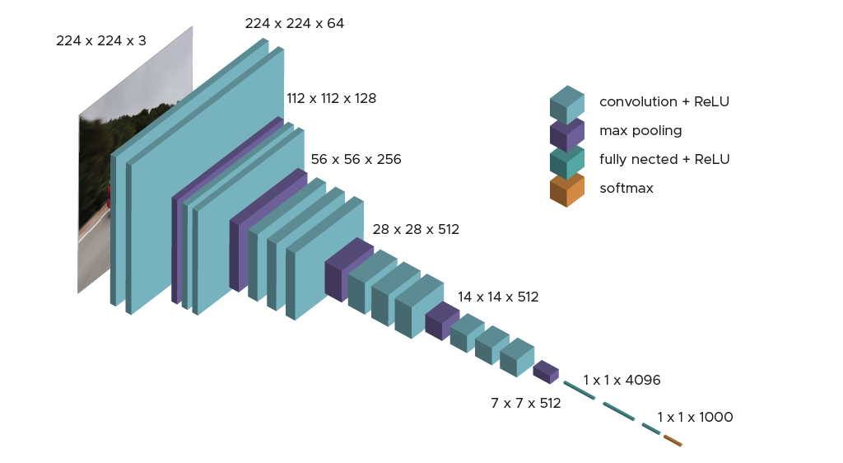
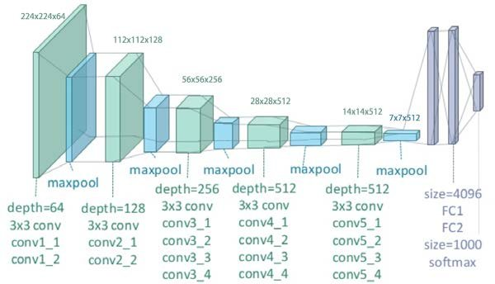
VGG19

Slide 9

GRAM MATRIX
By computing the Gram matrix for the feature maps of the style image and the generated image, the style loss can be calculated as the mean squared error between the Gram matrices.
This allows the neural network to learn how to match the style of the style image while preserving the content of the content image.
The Gram matrix is used in style transfer because it encodes the correlations between the different filter responses at each location in the feature maps.

Slide 10
3. GRAM MATRIX
There are many other similarity metrics that can be used to compare feature representations of images, such as:
Mean Squared Error (MSE)
Mean Absolute Error (MAE)
Cosine Similarity
Correlation Coefficient
Euclidean Distance
Histogram Intersection
In the case of style transfer, the Gram matrix has been found to be effective for capturing the style information of an image.

Slide 11

DEFINING LOSSES AND WEIGHTS
In any VGG model we need to check the loss.
In our project we are taking features from style image.
We are taking output features from 5 layers, so we assign weights to the feature obtained in each layer.
'conv1_1': 1,
'conv2_1': 0.75,
'conv3_1': 0.2,
'conv4_1': 0.2,
'conv5_1': 0.2

Slide 12

ADAM OPTIMIZER
The loss is calculated using style loss and content loss.
Style loss is the squared difference between gram matrix of style image and target image.
Content loss is calculated by mean of squared difference between content and target image’s “conv4_2”.
We are calculating this loss for 5000 times and printing the output after each 500steps.
Adam optimizer is used with a learning rate of 0.03 to reduce the loss.

Slide 13

Dataset
The data set we are using is ImageNet dataset.
ImageNet is a large-scale image recognition dataset that is commonly used to train and used as benchmark for image classification, object recognition and other computer vision tasks. It was created in 2009 by researchers at Stanford University, and it contains more than 14 million images covering over 20,000 categories.
We are using this dataset for training the VGG model.

Slide 14

Novelty
Style transformation is done either using gram matrix or vgg now we are trying to combine the advantage that we are going to obtain from vgg as well as gram matrix and we are designing a new model.

Slide 15

FUTURE WORKS
Style transfer is an active area of research and development in computer vision and deep learning, and there are several novel approaches and techniques that could be introduced to improve its performance and functionality. Here are some of them:
Multi-style transfer
Interactive style transfer
Adaptive style transfer
Fine-grained style transfer
Real-time style transfer

Slide 16

Related Works:
Jing, Y., Yang, Y., Feng, Z., Ye, J., Yu, Y., & Song, M. (2019). Neural style transfer: A review. IEEE transactions on visualization and computer graphics, 26(11), 3365-3385.
Cheng, J., Jaiswal, A., Wu, Y., Natarajan, P., & Natarajan, P. (2021). Style-aware normalized loss for improving arbitrary style transfer. In Proceedings of the IEEE/CVF Conference on Computer Vision and Pattern Recognition (pp. 134-143).
GATYS L A, ECKER A S, BETHGE M.A neural algorithm of artistic style[ J]. ArXiv preprint arXiv, 2015(8):13-18.
Qu Shicao. Research on Image Style Transfer Method Based on Deep Learning [D]. Shanghai Normal University, 2021. DOI: 10.27312/d.cnki.gshsu.2021.001768.
Leon A. Gatys, Alexander S. Ecker, and Matthias Bethge.“A Neural Algorithm of Artistic Style.”Preprint, submitted September 2, 2105.

Slide 17

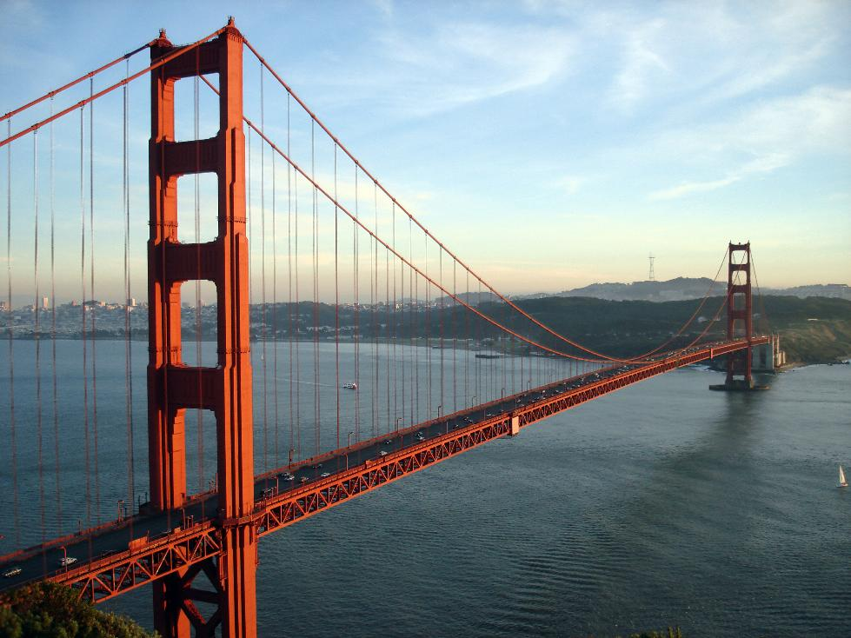
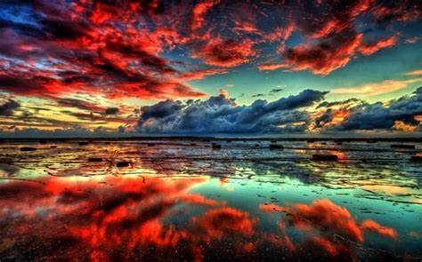
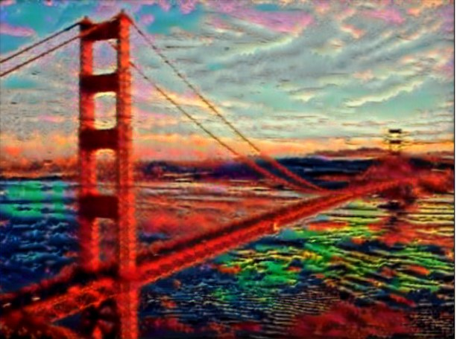
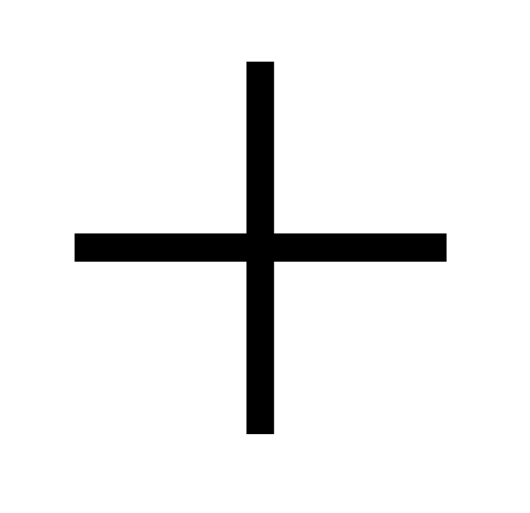

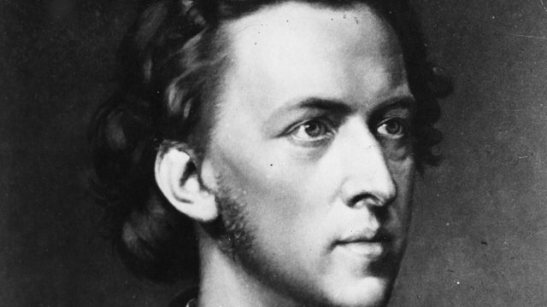
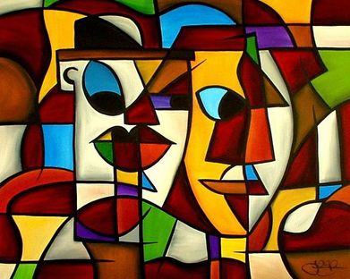
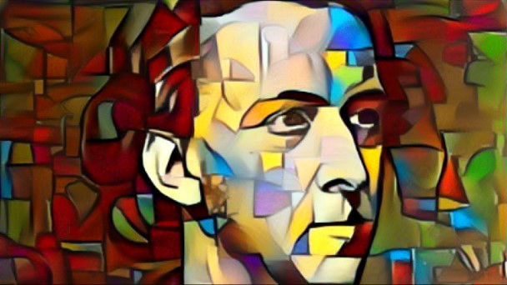
RESULTS

Slide 18

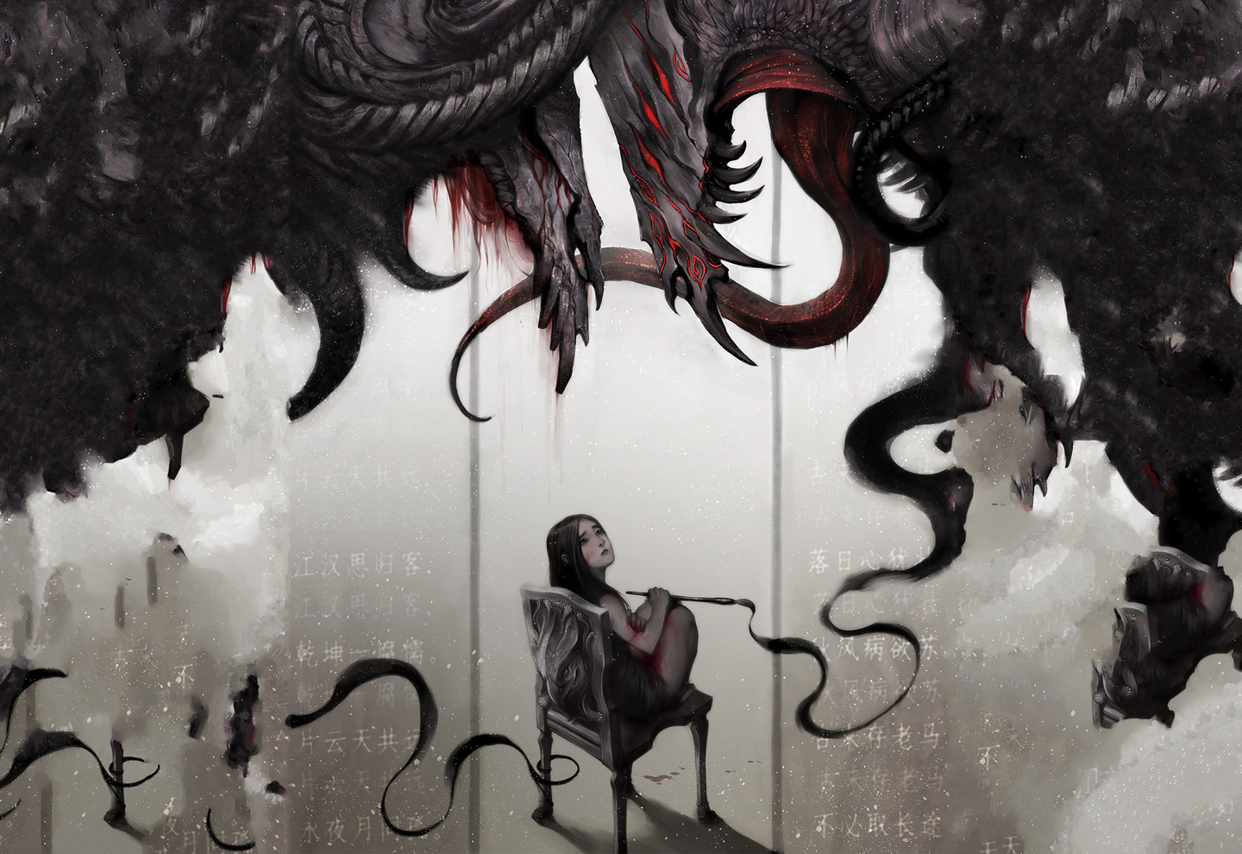
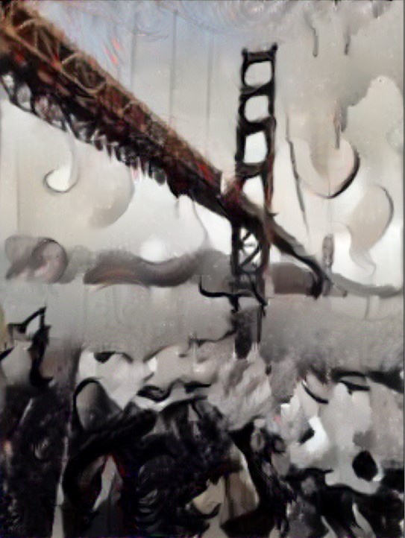
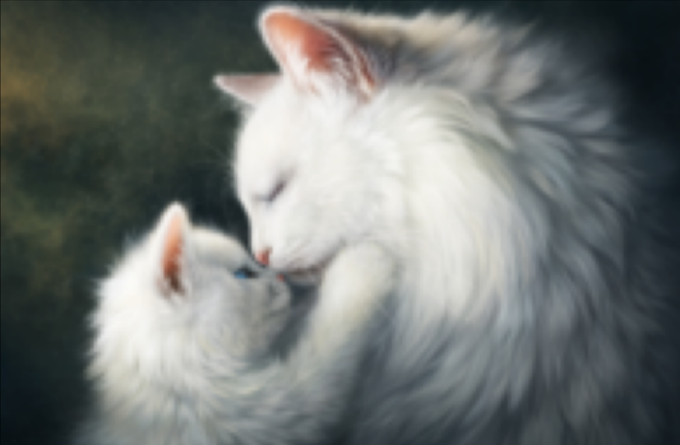
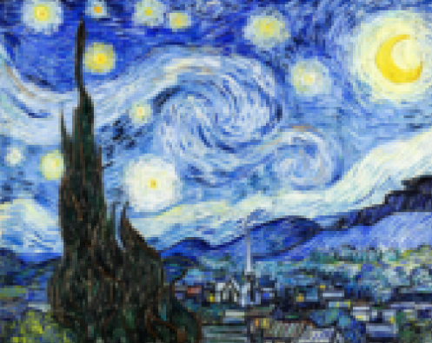
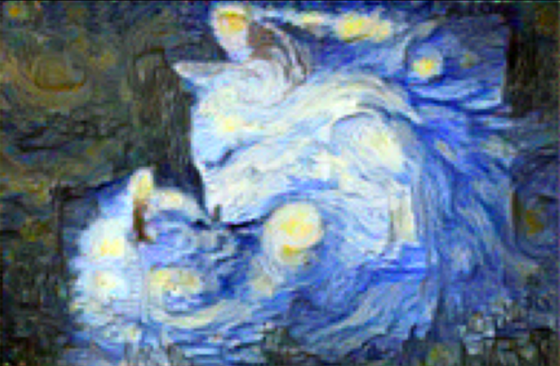
RESULTS

Slide 19

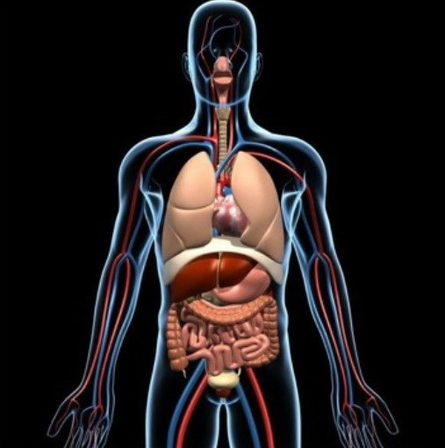
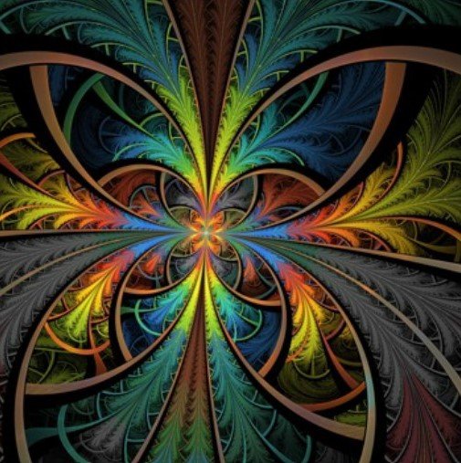
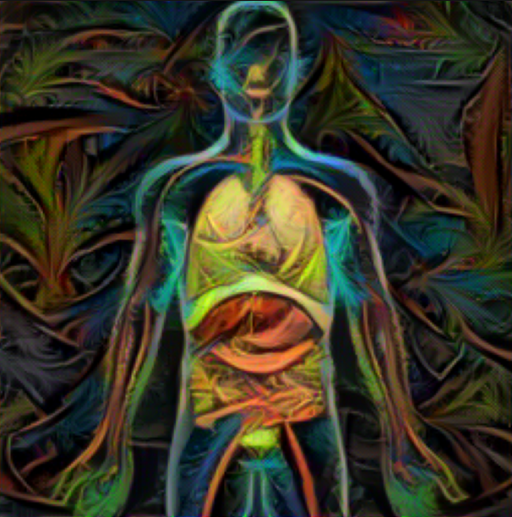
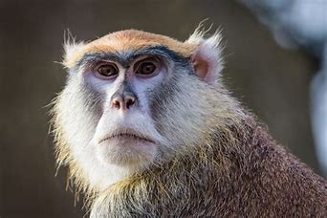
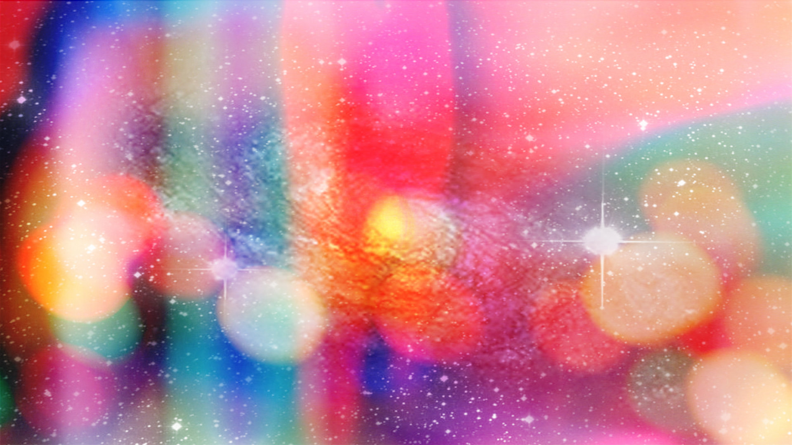
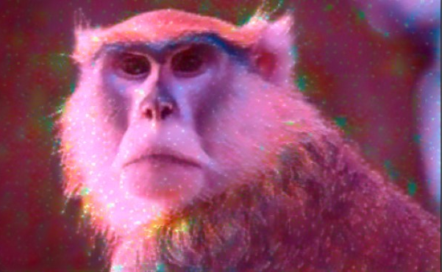
RESULTS

Slide 20
Thank you

